Slide 1


Slide 2

30 Days Python Master Class
Day1 : Python
Time: 6.00 PM IST
Free Registration

Slide 3
Python Master Class
Handbook

Slide 4
NANDHINI.S
Exp: 5 Yrs
Expert in
Python Developer on Machine Learning
Deep learning with computer vision
Matlab – Image Processing
Autonomous Car design using ROS with LIDAR
Language – Python , Java , HTML ,CSS.
Tools – ANACONDA NAVIGATOR, JUPYTER NOTEBOOK,
GOOGLE COLAB.
Graduation : BE – ECE | 2011

Slide 5
Pantech?
Educational Equipment Manufacturer
IoT, AI, Robotics,Autonomous Robot
Microprocessor/Microcontroller
DSP,VLSI, Embedded System
Power Electronics & Drives, Fuel Cell Trainer Kit
Renewable Energy Lab, Electric Vehicle Lab
Technical Training
DIY Project

Slide 6

What is Master Class ?
👍 This is the 30 Days Industrial Learning Activity.
👍 Its Online YouTube Live Class
👍 If you Invest 45 minutes daily, U will become Master in Data Science
👍 You will get FREE E-Certificate
Webinar Participation Certificate
“Learning is the beginning of wealth.
Searching & Learning is where the miracle process all begins.” …………….Jim Rohn

Slide 7
Our Vision
Help 10 Million Students to Learn the Technology in Easy Way

Slide 8

Associate Partner for this Master Class
https://apssdc.in/home/

Slide 9
What U will Learn from 30 Days Data Science & Analytics Master Class

Slide 10
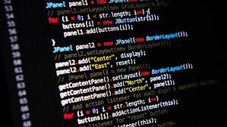




Python Learning Plan
01
02
03
04
05
Library
Python
Analytics
Analytics
Industry Project
Introduction To Python and Python Data Structures
Pandas
Numpy
MatplotLib
Cborn, SKLearn Lib
Collab
Distribution
Visualization
Aggregation
Statistics
Distribution Function
Project Building

Slide 11
Day wise Learning Plan
Day -1 : Introduction to Python
Day -2: Python – Tools|Syntaxes & Data Structures
Day -3: Python – Dictionaries,Date and Time
Day -4: Python – MySql
Day -5: Pandas library – Introduction
Day -6: Pandas library – Data Structures
Day -7: Numpy library – Introduction
Day -8: Numpy library – Array Manipulations, Mathematical Functions
Day -9: Matplotlib , Histogram Using Matplotlib | I/O With Numpy
Day -10: Matplotlib Library - Introduction , Pyplot API | Types Of Plots
Day -11: Seaborn Library
Day -12: SKLearn Library
Day -13: Python – Date and Time , Data Wrangling.
Day -14: Python – Data Cleansing
Day -15: Python – Word Tokenization , Stemming and Lammetization.

Slide 12
Day wise Learning Plan
Day -16: Python – Data Visualization
Day -17: Python – Statistical Analysis
Day -18: Python – Types Of Distribution
Day -19: Python – Correlation ,Chi-Square Test , Linear Regression
Day -20: Keras library – Introduction.
Day -21: Stock Price Prediction With Machine Learning LSTM RNN
Day -22: People’s behaviour in chat message using NLP NLP
Day -23: Gaming In Python
Day -24: Chatbot creation in Python NLP
Day -25: Electricity Price Prediction Using ML Random Forest Regressor
Day -26: Diamond Price Prediction Using Python Linear Regression
Day -27: Book Recommendation System KNN
Day -28: Image Classification Using CNN CNN
Day -29: Titanic Survival Analysis Using ML Logistic Regression
Day -30: Blockchain in Python

Slide 13
List of Projects for Demo in YouTube Live
Stock Price Prediction With Machine Learning
People’s behaviour in chat message using NLP
Gaming In Python
Chatbot creation in Python
Electricity Price Prediction Using ML
Diamond Price Prediction Using Python
Book Recommendation System
Image Classification Using CNN
Titanic Survival Analysis Using ML
Blockchain in Python
All Projects in Jupyter Notebook

Slide 14
What you will get from this Free 30 Days Master Class?
You can attend YouTube Live Class
Free E-Certificate ( WEBINAR PARTICIPATION CERTIFICATE)

Slide 15
How to mark your Attendance in YouTube Live Class?
Ans : During the Live Class, organizer will post Google Form link in Live Chat. The Participants should submit the from on daily basis. Minimum 25 Days Attendance is Required to get Free Master Class Participation Certificate.
Note : The Link will be available during the Live. From the LIVE Class date, the live video will get removed from the YouTube in 3 days.

Slide 16
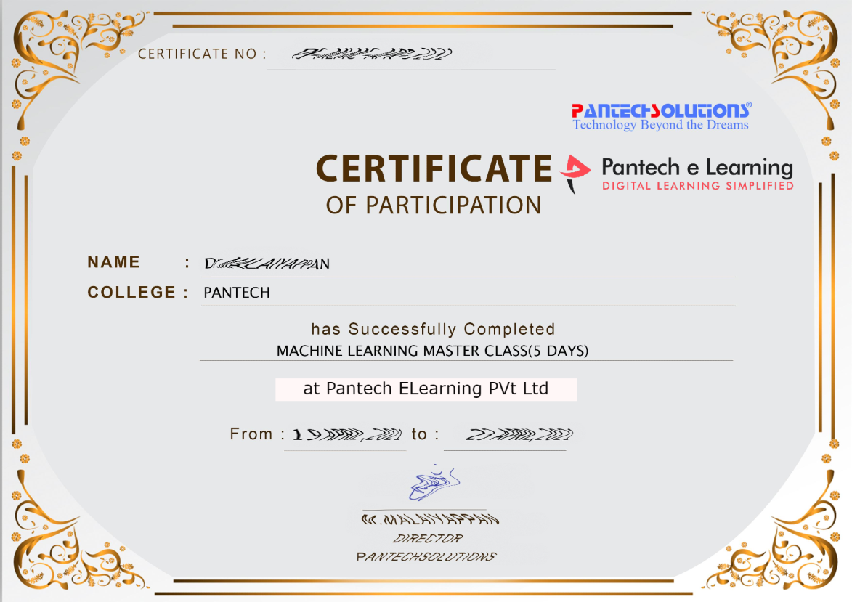

Sample Webinar Participation Certificate?

Slide 17
https://www.pantechelearning.com/data-science-master-class/
On Demand
You can get chance to apply 1 Month Internship on Data Science & Analytics Master Class

Slide 18
What is Internship????
Learn
Practice
Verify
Get Certified
Grow

Slide 19
Free Master Class DSA | 1 Month Internship on DSA
Master Class Participation Certificate | Internship Completion Certificate
Minimum 25 Class should attend YouTube Live | Recorded Class Link will be provided. – LMS Portal Access
YouTube Live Mandatory | Your Choice. You can attend Live or else You can watch Recorded Class in LMS Portal
All Projects Demo class in YouTube Live | Step by Step Video Explanation Content in LMS Portal
Access : 3 Days | VIP WhatsApp Group Support
 | You Can Download All PPTs
 | 4 Nos of Hackathon Class in Zoom Live. The Recording also will be provided
 | You Can Download All Project Files
 | Mentor will guide you to finish 10 Projects
 | Access : 60 Days

Slide 20
Pantech will make you to Create 10 Projects in Data Science & Analytics in 30 Days
Objective of this 30 Days Master Class

Slide 21
1 Month Internship in Data Science
INTERNSHIP E-Certificate(30Days Internship on Data Science Engineering)
Highly organized Video content
Download All Files
Download PPTs
Assignments
Flexible Time.
Access Period: 60Days from the date of payment

Slide 22
What You Will Get???
Complete Project Files
30 Days Learning Activity
Data Science Core Concepts
10 + Projects
Project PPT
Spatial Data Science For Covid-19 Disease Prediction
Parkinson’s Disease Prediction-XGBoost Classifier
House Price Prediction-Random Forest Regression
Customer Segmentation Using ML-K-Means Clustering
Home Loan Prediction-Decision Tree Classifier
Spam Classification-NLP
Hand Written Digit Recognition Using Python-CNN
Churn Prediction-Deep Learning
Crop Yield Prediction
Ground water level prediction
Video Class Access for 2 Months
Get chance to Enroll 1-Month Internship on demand

Slide 23

How to join in 1 month Internship
https://www.pantechelearning.com/pymc-internship/
Coupon Code: PYMC

Slide 24
Python – Data Visualization

Slide 25
Python – Chart Properties
It has good libraries for performing data visualization tasks.
Creating a Chart:
Numpy library is used to create the required numbers to be mapped for creating the chart.
Pyplot method in matplotlib is used for drawing the actual chart.

Slide 26
Python – Chart Properties
import numpy as np
import matplotlib.pyplot as plt
x = np.arange(0,10)
y = x ^ 2
#Simple Plot
plt.plot(x,y)

Slide 27
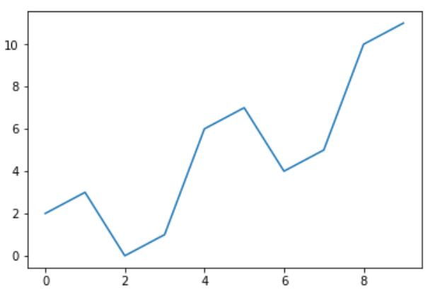
Output

Slide 28
Python – Labling The Axes
Labels can be applied to the axes as well as titles for the chart using appropriate methods from the library.
import numpy as np
import matplotlib.pyplot as plt
x = np.arange(0,10)
y = x ^ 2
#Labeling the Axes and Title
plt.title("Graph Drawing")
plt.xlabel("Time")
plt.ylabel("Distance") #Simple Plot
plt.plot(x,y)

Slide 29
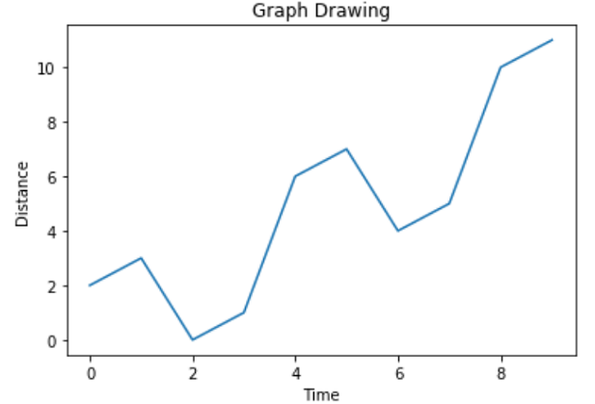
Output

Slide 30
Python – Formatting Line Type and Colour
The style as well as the color of the line in the chart can be specified using the appropriate methods in the library.
import numpy as np
import matplotlib.pyplot as plt
x = np.arange(0,10)
y = x ^ 2 #Labeling the Axes and Title
plt.title("Graph Drawing")
plt.xlabel("Time")

Slide 31
Python – Formatting Line Type and Colour
plt.ylabel("Distance")
# Formatting the line colors
plt.plot(x,y,'r')
# Formatting the line type
plt.plot(x,y,'>')

Slide 32
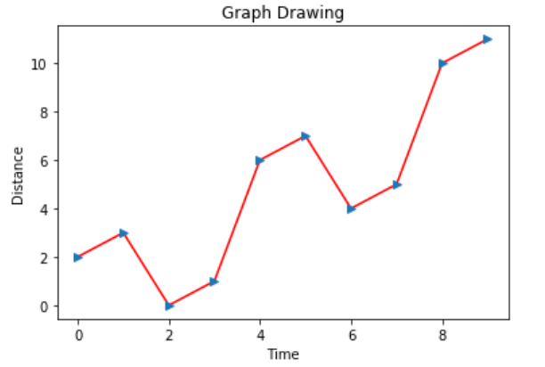
Formatting Line Type and Colour - Output

Slide 33
Saving The Chart File
The charts can be saved in different file formats using appropriate methods in the library.
import numpy as np
import matplotlib.pyplot as plt
x = np.arange(0,10)
y = x ^ 2
#Labeling the Axes and Title
plt.title("Graph Drawing")
plt.xlabel("Time")
plt.ylabel("Distance")

Slide 34
Saving The Chart File
# Formatting the line colors
plt.plot(x,y,'r')
# Formatting the line type
plt.plot(x,y,'>')
# save in pdf formats
plt.savefig('timevsdist.pdf', format='pdf')

Slide 35
Python – Chart Styling
The charts in python can have further styling by using some appropriate methods from the libraries for further charting.

Slide 36
Python – Adding Annotations
We need to annotate the chart by highlighting the specific locations of the chart.
Sharp change in the values in the chart are highlighted by adding some annotations at those points.

Slide 37
Python – Adding Annotations
import numpy as np
from matplotlib import pyplot as plt
x = np.arange(0,10)
y = x ^ 2
z = x ^ 3
t = x ^ 4

Slide 38
Python – Adding Annotations
# Labeling the Axes and Title
plt.title("Graph Drawing")
plt.xlabel("Time")
plt.ylabel("Distance")
plt.plot(x,y)
#Annotate
plt.annotate(xy=[2,1], s='Second Entry')
plt.annotate(xy=[4,6], s='Third Entry')

Slide 39
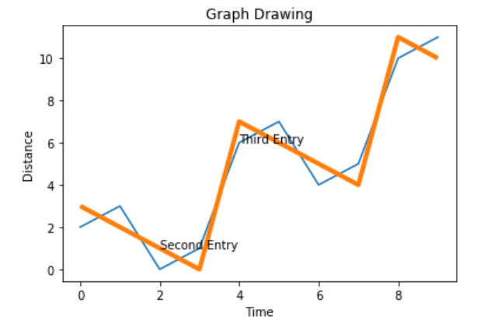
Python – Adding Annotations - Output

Slide 40
Python – Adding Legends
We need a chart with multiple lines being plotted.
Legend is used in order to find the meaning associated with each line.
3 lines are being plotted with appropriate legends.
import numpy as np
from matplotlib import pyplot as plt
x = np.arange(0,10)
y = x ^ 2
z = x ^ 3
t = x ^ 4

Slide 41
Python – Adding Legends
# Labeling the Axes and Title
plt.title("Graph Drawing")
plt.xlabel("Time")
plt.ylabel("Distance")
plt.plot(x,y)

Slide 42
Python – Adding Legends
#Annotate
plt.annotate(xy=[2,1], s='Second Entry')
plt.annotate(xy=[4,6], s='Third Entry')
# Adding Legends
plt.plot(x,z)
plt.plot(x,t)
plt.legend(['Race1', 'Race2','Race3'], loc=4)

Slide 43
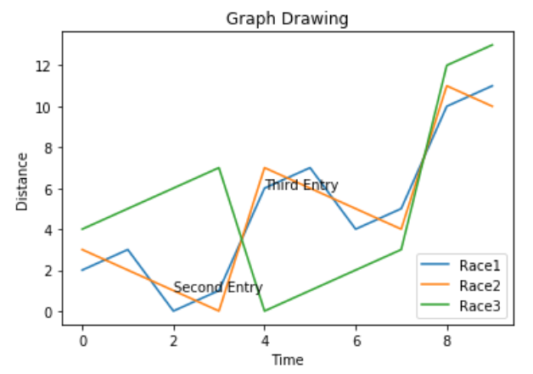
Python - Output

Slide 44
Python – Chart Presentation Style
The presentation style of the chart can be modified by using different methods from the style package.
import numpy as np
from matplotlib import pyplot as plt
x = np.arange(0,10)
y = x ^ 2
z = x ^ 3
t = x ^ 4

Slide 45
Python – Chart Presentation Style
# Labeling the Axes and Title
plt.title("Graph Drawing")
plt.xlabel("Time")
plt.ylabel("Distance")
plt.plot(x,y)

Slide 46
Python – Chart Presentation Style
#Annotate
plt.annotate(xy=[2,1], s='Second Entry')
plt.annotate(xy=[4,6], s='Third Entry')
# Adding Legends
plt.plot(x,z)
plt.plot(x,t)
plt.legend(['Race1', 'Race2','Race3'], loc=4)
#Style the background
plt.style.use('fast')
plt.plot(x,z)

Slide 47
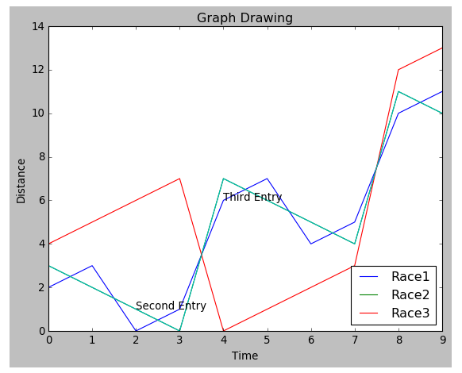
Chart Presentation Style - Output

Slide 48
Python – Box Plots
They are measure of how well distributed the data in a dataset is.
It divides the dataset into three quartiles.
This graph represents the minimum, maximum, median, first quartile and third quartile in the dataset.
It is useful in comparing the distribution of data across datasets by drawing boxplots for each of them.

Slide 49
Python – Box Plots
Boxplots can be drawn calling Series.box.plot() and DataFrame.box.plot() .
DataFrame.boxplot() is used to visualize the distribution of values within each column.
The boxplot denotes five trials of 10 observations of a uniform random variable on [0,1).
import pandas as pd
import numpy as np
df = pd.DataFrame(np.random.rand(10, 5), columns=['A', 'B', 'C', 'D', 'E'])
df.plot.box(grid='True')

Slide 50
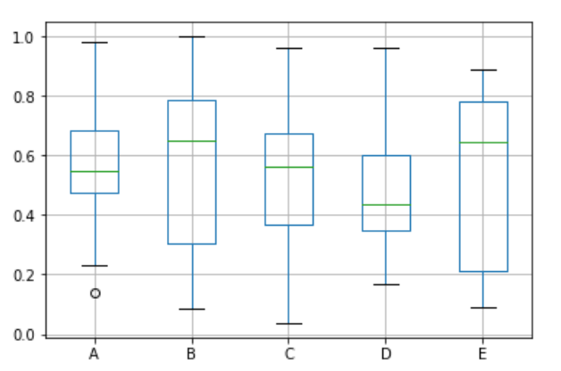
Box Plot - Output

Slide 51
Python – Heat Maps
A heatmap contains values representing various shades of the same colour for each value to be plotted.
The darker shades of the chart denote higher values than the lighter shade.
For a very different value , a completely different colour can also be used.
There is a two – dimensional plot of values which are mapped to the indices and columns of the chart.

Slide 52
Python – Heat Maps
from pandas import DataFrame
import matplotlib.pyplot as plt
data=[{2,3,4,1},{6,3,5,2},{6,3,5,4},{3,7,5,4},{2,8,1,5}]
Index= ['I1', 'I2','I3','I4','I5']
Cols = ['C1', 'C2', 'C3','C4']
df = DataFrame(data, index=Index, columns=Cols)
plt.pcolor(df)
plt.show()

Slide 53
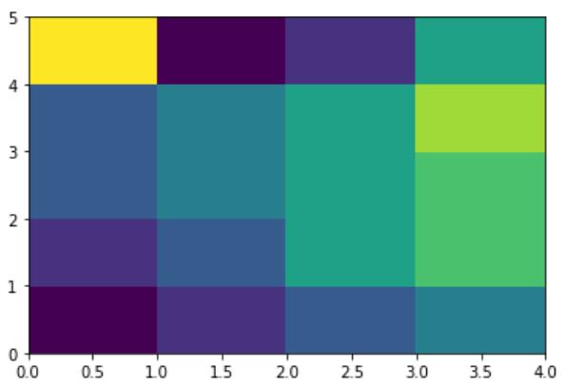
Python – Heat Maps - Output

Slide 54
Python – Scatter Plots
Scatter plots show many points plotted in the cartesian plane.
Each point represents the values of two variables.
One variable is chosen in the horizontal axis and one in the vertical axis.

Slide 55
Drawing a Scatter Plot
import pandas as pd
import numpy as np
df = pd.DataFrame(np.random.rand(50, 4), columns=['a', 'b', 'c', 'd']) df.plot.scatter(x='a', y='b')

Slide 56
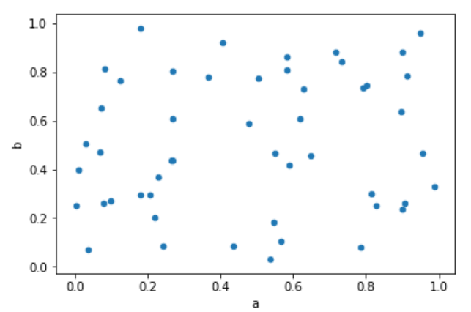
Scatter Plot - Output

Slide 57
Python – Bubble Charts
They display data as a cluster of circles.
Data required to create bubble charts needs to have xy coordinates , size of the bubble and colour of the bubbles.
The colours are given by the library.

Slide 58
Python – Drawing a Bubble Chart
import matplotlib.pyplot as plt
import numpy as np
# create data
x = np.random.rand(40)
y = np.random.rand(40)
z = np.random.rand(40)
colors = np.random.rand(40)
# use the scatter function
plt.scatter(x, y, s=z*1000,c=colors)
plt.show()

Slide 59
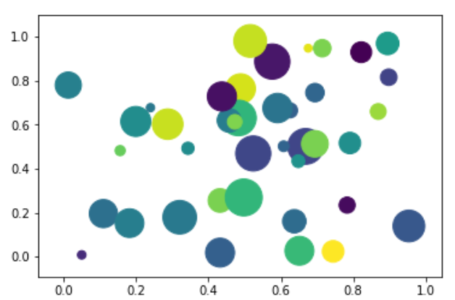
Bubble Chart - Output

Slide 60
Python – 3D Charts
It is also capable of creating 3D charts.
It involves adding a subplot to an existing 2D – plot and it assigns the projection parameter as 3D.

Slide 61
Python – Drawing a 3D Plot
from mpl_toolkits.mplot3d import axes3d
import matplotlib.pyplot as plt
chart = plt.figure()
chart3d = chart.add_subplot(111, projection='3d')
# Create some test data.
X, Y, Z = axes3d.get_test_data(0.08)
# Plot a wireframe.
chart3d.plot_wireframe(X, Y, Z, color='r',rstride=15, cstride=10)
plt.show()

Slide 62
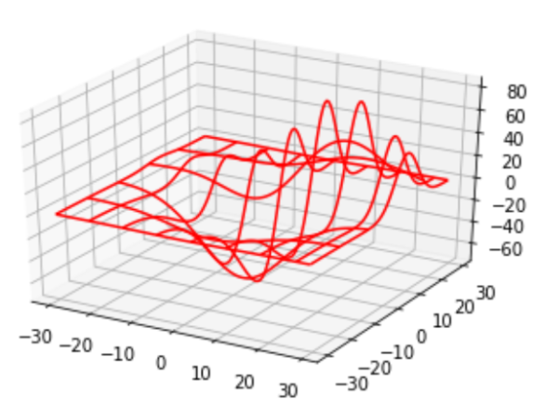
Drawing a 3D Plot - Output

Slide 63
Python – Graph Data
CSGraph stands for Compressed Sparse Graph.
It focuses on fast graph algorithms based on sparse matrix representations.
Graph Representations:
We should know what is sparse graph and how it helps in graph representations.

Slide 64
Sparse Graph
A graph is nothing but a collection of nodes , which have links between them.
Graphs can be used to represent anything like social network connections , where each node is a person and connected to acquaintances; images , where each node is a pixel and connected to neighbouring pixels.
The points lie in a high – dimensional distribution , where each node is connected to the nearest neighbours and practically anything else we can imagine.

Slide 65
Sparse Graph
One very efficient way to represent graph data is a sparse matrix.
It is called as G.
The matrix G is of size N*N.
G[i,j] gives the value of connection between node ‘i’ and node ‘j’.
A sparse graph contains mostly zeros – that is , most nodes have only a few connections.
IsoMap: A manifold learning algorithm , which requires finding the shortest paths in the graph.

Slide 66
Sparse Graph
Hierarchical Clustering: A clustering algorithm based on minimum spanning tree.
Spectral Decomposition: A projection algorithm based on sparse graph laplacians.

Slide 67
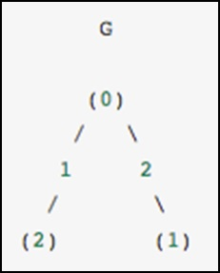
Sparse Graph

Slide 68
Sparse Graph - Examples
The graph contains three nodes , where node 0 and 1 are connected by an edge of weight 2 , nodes 0 and 2 are connected by an edge of weight 1.
A unidiretced graph is denoted by a symmetric matrix.

Slide 69
Sparse Graph - Examples
G_dense = np.array([ [0, 2, 1],
[2, 0, 0],
[1, 0, 0] ])
G_masked = np.ma.masked_values(G_dense, 0)
from scipy.sparse import csr_matrix
G_sparse = csr_matrix(G_dense)
print (G_sparse.data)

Slide 70
Sparse Graph - Output
array([2, 1, 2, 1])

